Slide 1
Kaggle训练营

Slide 2
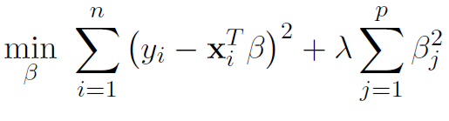
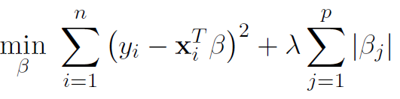
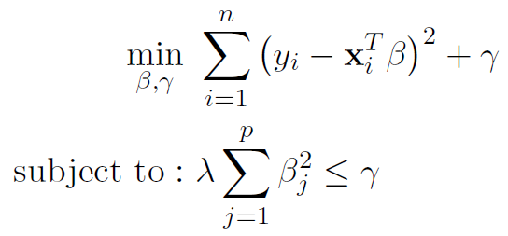
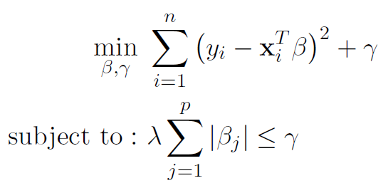
Lasso and Ridge Model
Ridge Regression (Squared Penalty)
Objective Function Equivalent to
Lasso Regression (Absolute Penalty)
Objective Function Equivalent to

Slide 3
How to Optimize lambda of the Model
Plot learning curve of the training set / test set
Cross-validation
Problem of the current method? The estimation heavily depends on the test set (high variance)
K-Fold Cross-Validation (usually 5 to 10, depends on how large is the data)
1. Separate training set into K different, equally sized sets
2. for each tunable parameter value
For k=1, 2, ….K:
Use all of the data except fold k as a training set to fit the function with parameter lambda
Use fold k as a training set
Estimate squared error on fold k
Average errors to approximate expected predictive error
3. Pick parameter with the lower error

Slide 4
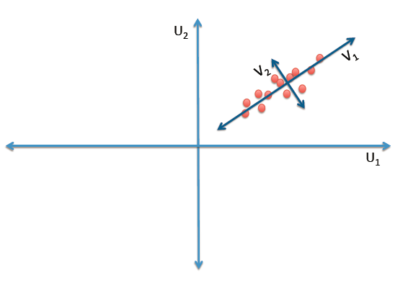
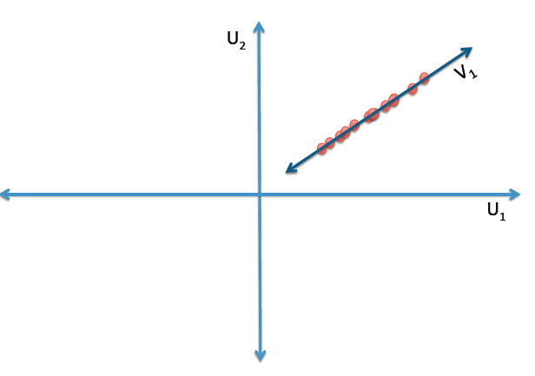
Principal Components Analysis (PCA)
PCA is a dimensionality reduction method, which uses a k dimension data set to represent the original n dimension data set
Principal Components (PCs) are associated with the eigenvectors of the covariance of the data.
The ith principal component (PC) is the line that follows the eigenvector associated with the ith largest eigenvalue.
the ith eigenvalue measure the variance in the direction of the ith principal component.

Slide 5
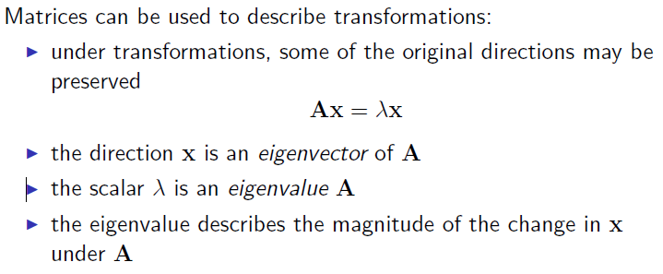
Eigenvalue and Eigenvector

Slide 6
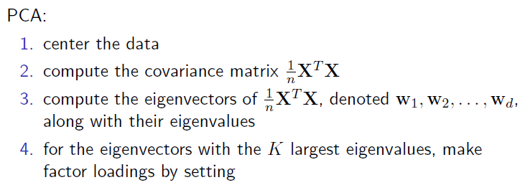
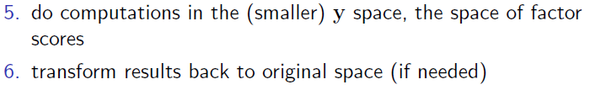
Principal Components Analysis (PCA)

Slide 7
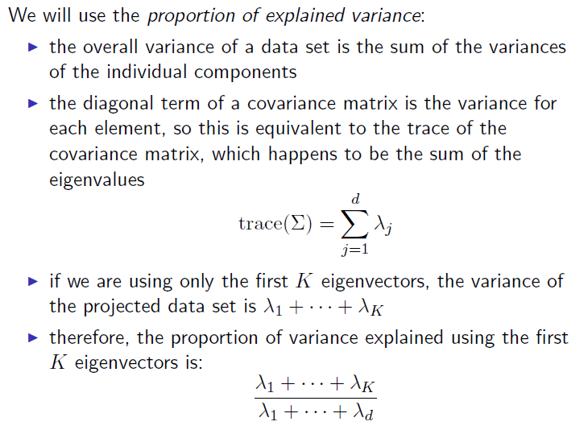
Principal Components Analysis (PCA)

